Slide 1
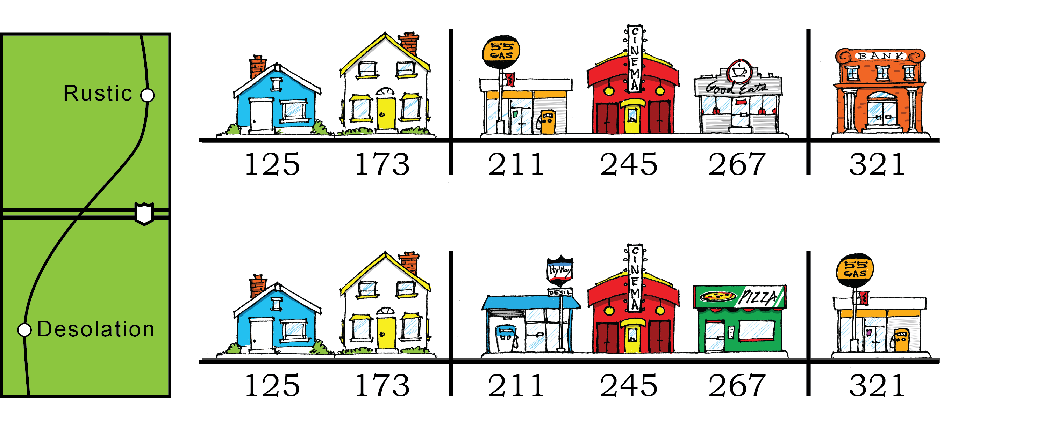
Notes:
Figure 1. The Towns of Rustic and Desolation. Addresses represent chromosomal loci…physical positions along a chromosome. At each address there is a building that performs a function (housing at 125 and 173, gas at 211, restaurant at 267, etc.); these functions are analogous to genes, each of which encodes a particular function in the organism. Even though the towns have the about the same functions in similar positions, they are not identical. For example, Rustic has a dinner at 267 while Desolation has a pizza place at that address. These two restaurants could be considered “allelic”– serving the same function but in subtly different ways. The buildings (loci) at address 321 challenge the definition above. A bank and a gas station are NOT allelic. Rather, the towns have diverged at this address to the point where address (locus) now encodes a different function (gene) in each town.

Slide 2
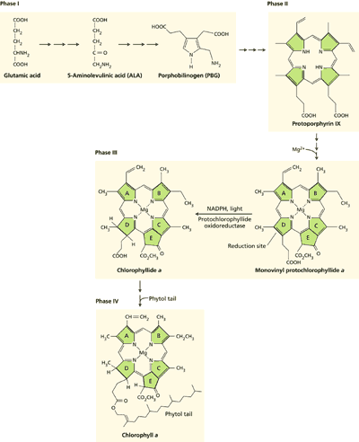
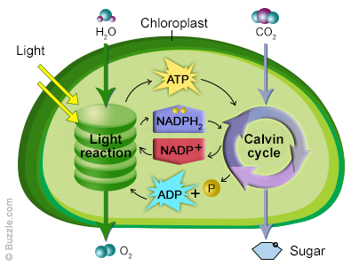
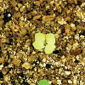
It isn’t easy being green…
Chlorophyll biosynthesis (Taiz and Zeiger, http://5e.plantphys.net/article.php?id=76)
Notes:
The chlorophyll biosynthetic pathway includes many enzyme-catalyzed steps through which small molecule precursors are used to build the light-harvesting chlorophyll molecule (left panel). It is likely that mutations which disrupt the coding potential of loci that specify the enzymes required for chlorophyll biosynthesis will yield a pale-green or albino phenotype

Slide 3
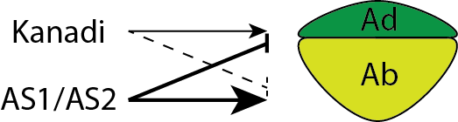
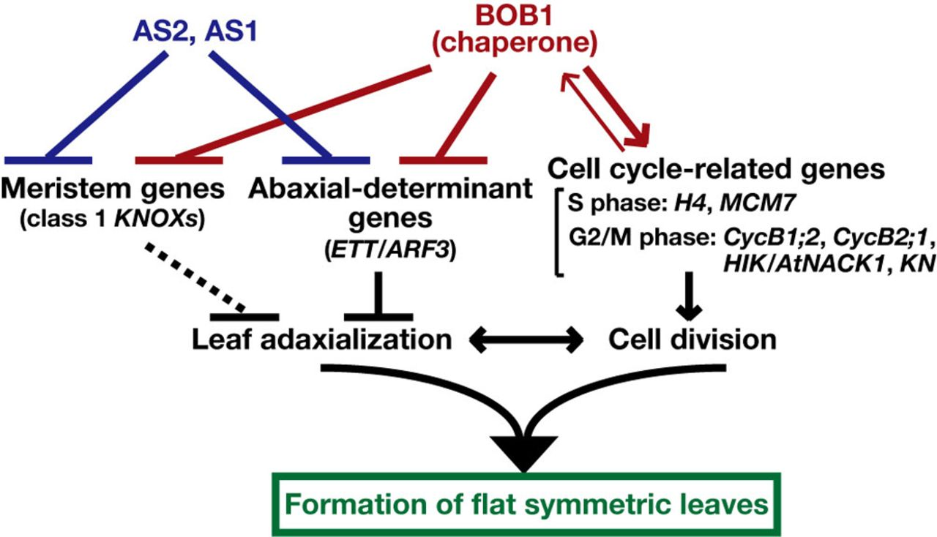
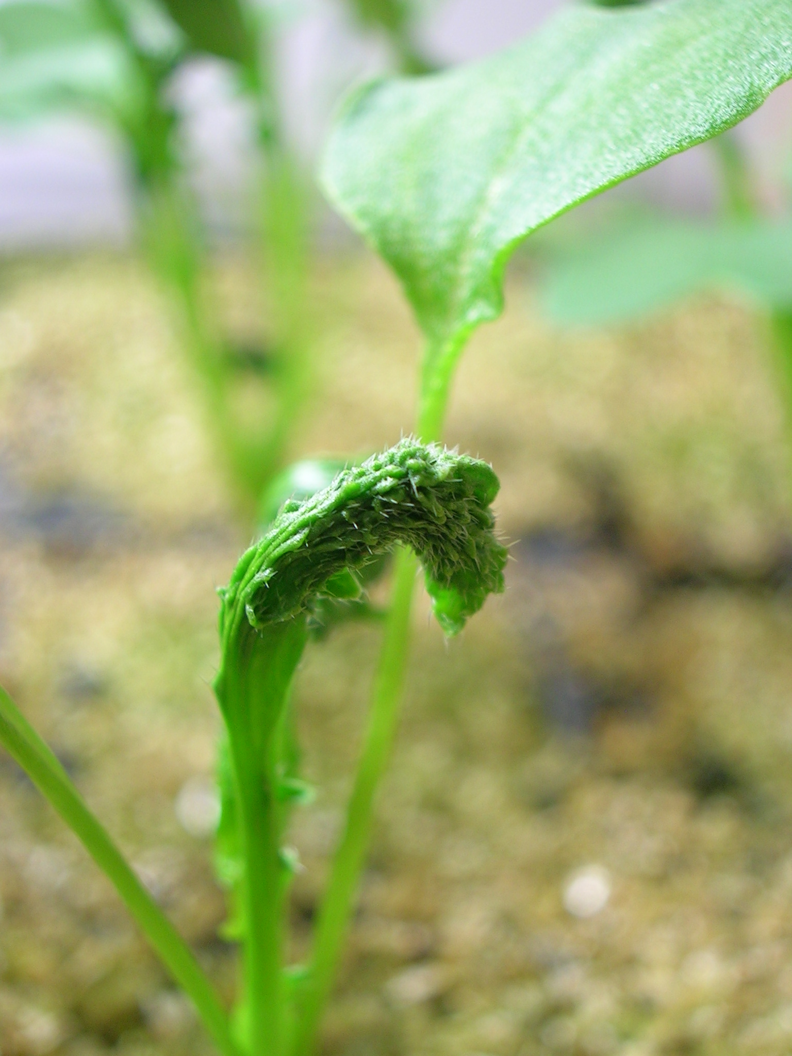
It isn’t easy being flat, either…
Ishibashi N et al. Biology Open 2012;1:197-207
Notes:
The allocation of primordial cells of the shoot apical meristem into adaxial (upper) and abaxial (lower) cell types requires the concerted activities of many gene products. Proper allocation is required to yield the flat solar panels we recognize as leaves. Among those gene products are those encoded by the AS1, AS2, and Kanadi gene families which serve as master regulatory factors governing leaf formation. Misexpression of the AS2 gene product, as occurs in the FPsc ale mutant, results in tightly curled leaves.

Slide 4
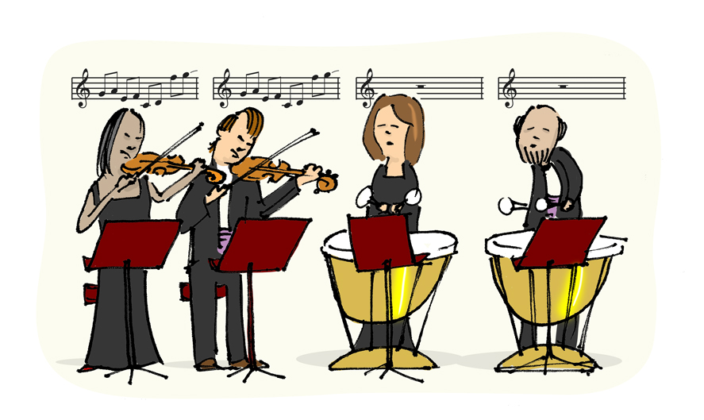
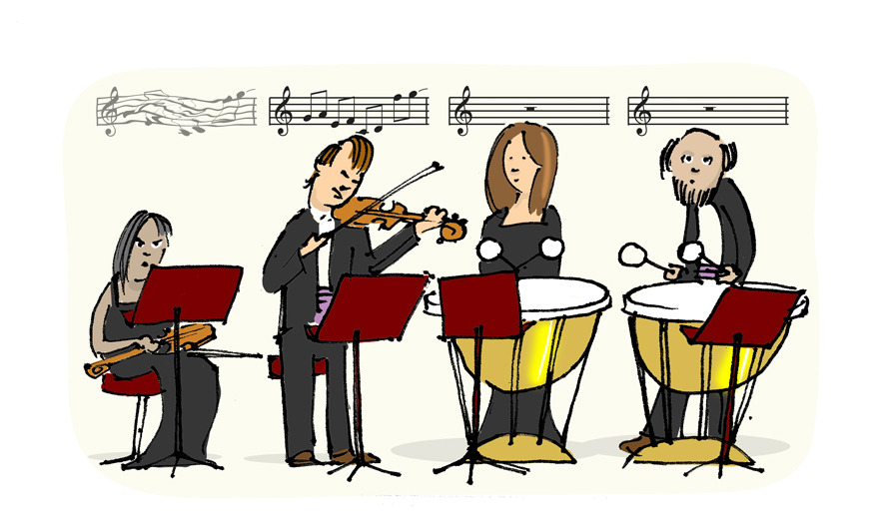
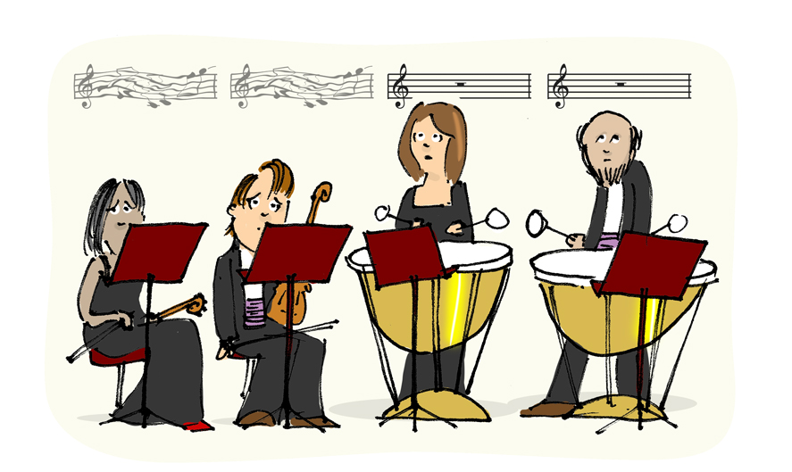
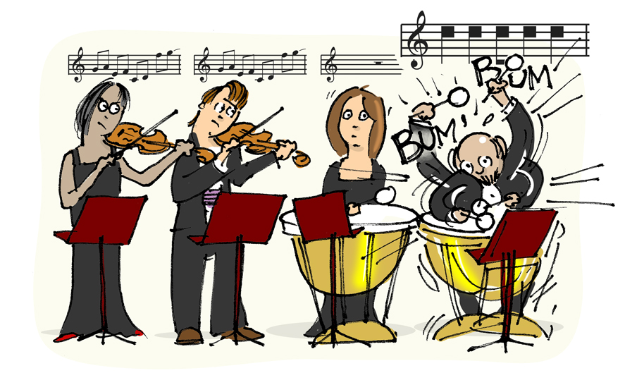
Notes:
Figure 4. Musical Mutations (see the following slides for notes on each panel.)

Slide 5
Notes:
Figure 4a. With all sheet music correct the violins play while the tympani rest. This is analogous to an organism with all wildtype alleles.

Slide 6
Notes:
Figure 4b. Even though one violinist has bad sheet music, the other violinist can play and the piece can be performed. The violinist with the bad sheet music is analogous to a recessive, loss-of-function allele. The normal sheet music (wildtype allele) is dominant and determines the phenotype.

Slide 7
Notes:
Figure 4c. When both violinists have bad sheet music, the piece can no longer be performed. This is analogous to an individual being homozygous recessive for a loss-of-function allele.

Slide 8
Notes:
Figure 4d. One tympanist has bad sheet music causing him to play (loudly!) when he should rest. Even though all other sheet music is correct, the single bad copy disrupts the performance. This is analogous to a dominant gain-of-function allele. The other tympani represents a wildtype allele which, in this case, is recessive to the gain-of-function allele.

